Slide 1
Trigonometric Functions
Graphing the Trigonometric Function

Slide 2
E.Q: E.Q
1. What is a radian and how do I use it to determine angle measure on a circle?
2. How do I use trigonometric functions to model periodic behavior?
CCSS: F.IF. 2, 4, 5 &7E; F.TF. 1,2,5 &8

Slide 3
Mathematical Practices:
1. Make sense of problems and persevere in solving them.
2. Reason abstractly and quantitatively.
3. Construct viable arguments and critique the reasoning of others.
4. Model with mathematics.
5. Use appropriate tools strategically.
6. Attend to precision.
7. Look for and make use of structure.
8. Look for and express regularity in repeated reasoning.

Slide 4

Right Triangle Trigonometry
SOH CAH TOA
CHO SHA CAO
Graphing the Trig Function

Slide 5

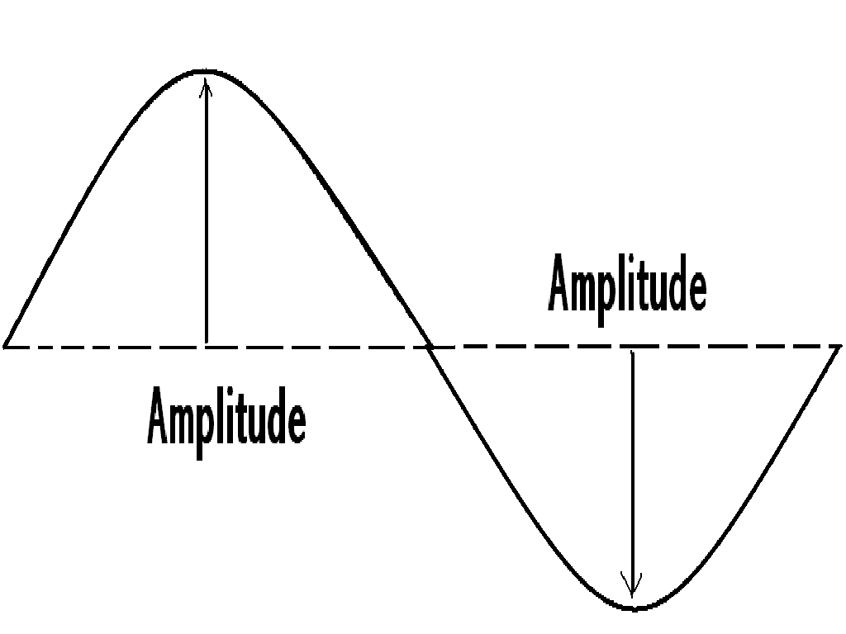
Graphing Trigonometric Functions
Amplitude: the maximum or minimum vertical distance between the graph and the x-axis. Amplitude is always positive

Slide 6







Amplitude
The amplitude of y = a sin x (or y = a cos x) is half the distance between the maximum and minimum values of the function.
amplitude = |a|
If |a| > 1, the amplitude stretches the graph vertically.
If 0 < |a| > 1, the amplitude shrinks the graph vertically.
If a < 0, the graph is reflected in the x-axis.
y
y = sin x
x
y = sin x
y = – 4 sin x
y = 2 sin x
reflection of y = 4 sin x
y = 4 sin x

Slide 7
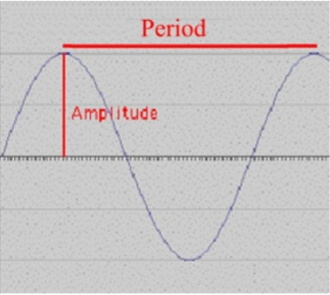
Graphing Trigonometric Functions
Period: the number of degrees or radians we must graph before it begins again.

Slide 8
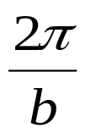
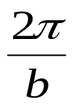





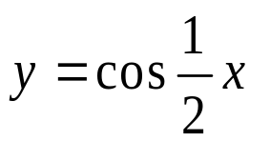






Period of a Function
The period of a function is the x interval needed for the function to complete one cycle.
For b > 0, the period of y = a sin bx is .
For b > 0, the period of y = a cos bx is also .
If 0 < b < 1, the graph of the function is stretched horizontally.
y
period: 2
period:
x
If b > 1, the graph of the function is shrunk horizontally.
y
period: 2
period: 4
x

Slide 9
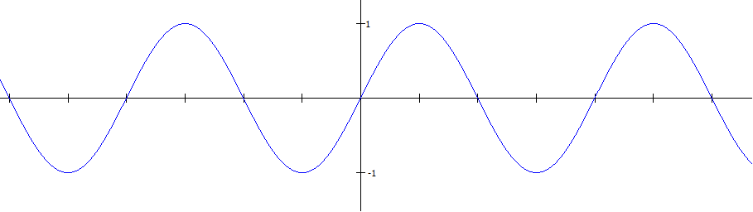

Sine is a periodic function: p = 2π
sin θ
−3π
−2π
−π
0
π
2π
3π
θ
One period
2π
sin θ: Domain (angle measures): all real numbers, (−∞, ∞)
Range (ratio of sides): −1 to 1, inclusive [−1, 1]
sin θ is an odd function; it is symmetric wrt the origin.
sin(−θ) = −sin(θ)

Slide 10




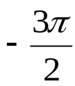








Sine Function
Graph of the Sine Function
To sketch the graph of y = sin x first locate the key points.
These are the maximum points, the minimum points, and the intercepts.
x
0
sin x
0
1
0
-1
0
Then, connect the points on the graph with a smooth curve that extends in both directions beyond the five points. A single cycle is called a period.
y
y = sin x
x

Slide 11
Cosine Function
Graph of the Cosine Function
To sketch the graph of y = cos x first locate the key points.
These are the maximum points, the minimum points, and the intercepts.
x
0
cos x
1
0
-1
0
1
Then, connect the points on the graph with a smooth curve that extends in both directions beyond the five points. A single cycle is called a period.
y
y = cos x
x

Slide 12
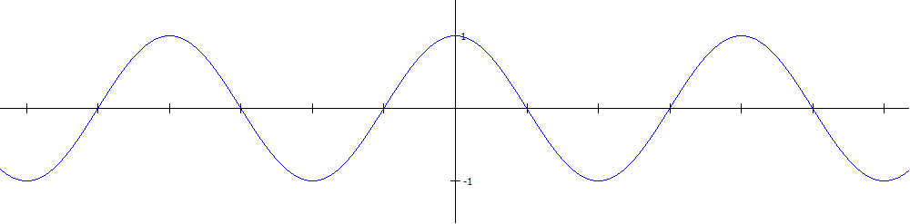
Cosine is a periodic function: p = 2π
cos θ
θ
−3π
−2π
−π
0
π
2π
3π
One period
2π
cos θ: Domain (angle measures): all real numbers, (−∞, ∞)
Range (ratio of sides): −1 to 1, inclusive [−1, 1]
cos θ is an even function; it is symmetric wrt the y-axis.
cos(−θ) = cos(θ)

Slide 13
Properties of Sine and Cosine graphs
The domain is the set of real numbers
The range is set of “y” values such that -1≤ y ≤1
The maximum value is 1 and the minimum value is -1
The graph is a smooth curve
Each function cycles through all the values of the range over an x interval or 2π
The cycle repeats itself identically in both direction of the x-axis

Slide 14
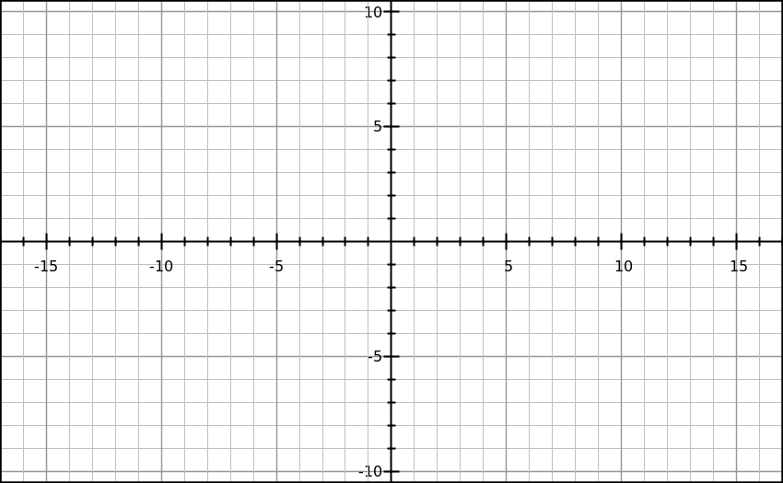
Given : A sin Bx
  Amplitude = IAI
  period = 2π/B
Sine Graph
Example:
y=5sin2X
Amp=5
Period=2π/2
= π
π/2
π
π/4
3π/4

Slide 15













Example: y = 3 cos x
Example: Sketch the graph of y = 3 cos x on the interval [–π, 4π].
Partition the interval [0, 2π] into four equal parts. Find the five key points; graph one cycle; then repeat the cycle over the interval.
x
0
π
2π
y = 3 cos x
3
0
-3
0
3
max
x-int
min
x-int
max
y
(0, 3)
( , 3)
x
( , 0)
( , 0)
( , –3)

Slide 16
Graph y = f(-x)
Use basic trigonometric identities to graph y = f (–x)
Example : Sketch the graph of y = sin (–x).
The graph of y = sin (–x) is the graph of y = sin x reflected in
the x-axis.
y
y = sin (–x)
Use the identity
sin (–x) = – sin x
x
y = sin x
Example : Sketch the graph of y = cos (–x).
The graph of y = cos (–x) is identical to the graph of y = cos x.
y
Use the identity
cos (–x) = + cos x
x
y = cos (–x)
y = cos (–x)

Slide 17
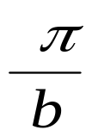















Example: y = 2 sin(-3x)
Example: Sketch the graph of y = 2 sin (–3x).
Rewrite the function in the form y = a sin bx with b > 0
Use the identity sin (– x) = – sin x:
y = 2 sin (–3x) = –2 sin 3x
2
2
amplitude: |a| = |–2| = 2
period:
=
3
Calculate the five key points.
x
0
y = –2 sin 3x
0
–2
0
2
0
y
( , 2)
x
(0, 0)
( , 0)
( , 0)
( , -2)

Slide 18
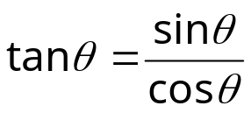


Tangent Function
Recall that .
Since cos θ is in the denominator, when cos θ = 0, tan θ is undefined.
This occurs @ π intervals, offset by π/2: { … −π/2, π/2, 3π/2, 5π/2, … }
Let’s create an x/y table from θ = −π/2 to θ = π/2 (one π interval),
with 5 input angle values.
θ | sin θ | cos θ | tan θ
−π/2
−π/4
0
π/4
π/2
θ | tan θ
−π/2 | und
−π/4 | −1
0 | 0
π/4 | 1
π/2 | und
−1
0
und
−1
0
1
0
1
1
0
und

Slide 19
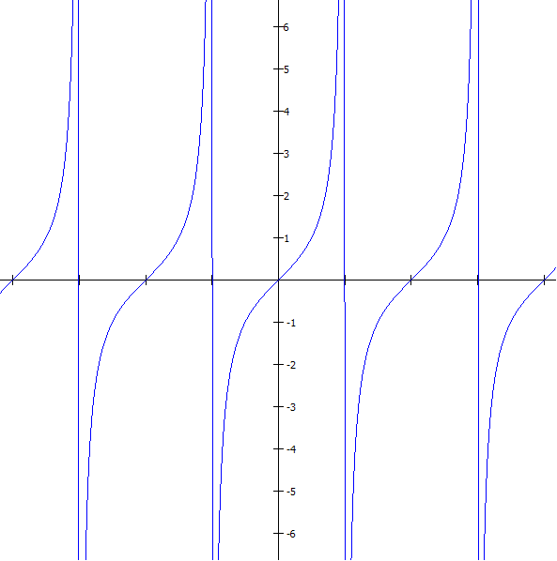
Graph of Tangent Function: Periodic
Vertical asymptotes
where cos θ = 0
θ | tan θ
−π/2 | Und (-∞)
−π/4 | −1
0 | 0
π/4 | 1
π/2 | Und(∞)
tan θ
−3π/2
3π/2
−π/2
0
π/2
θ
One period: π
tan θ: Domain (angle measures): θ ≠ π/2 + πn
Range (ratio of sides): all real numbers (−∞, ∞)
tan θ is an odd function; it is symmetric wrt the origin.
tan(−θ) = −tan(θ)

Slide 20
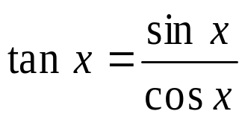
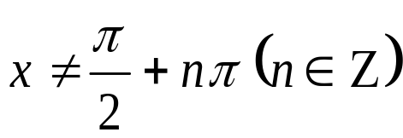


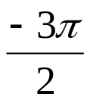

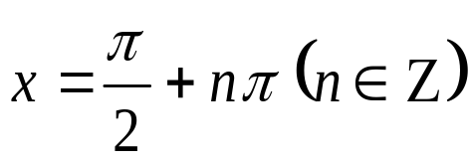

Tangent Function
Graph of the Tangent Function
To graph y = tan x, use the identity .
At values of x for which cos x = 0, the tangent function is undefined and its graph has vertical asymptotes.
y
Properties of y = tan x
1. Domain : all real x
2. Range: (–∞, +∞)
x
3. Period: π
4. Vertical asymptotes:
period:

Slide 21
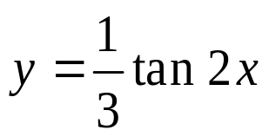
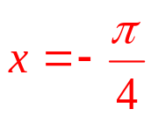
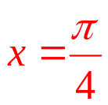



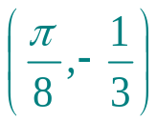

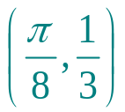
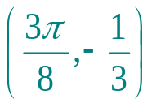
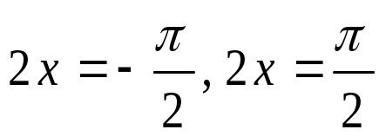
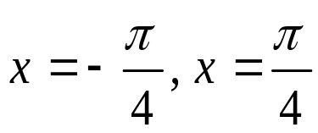
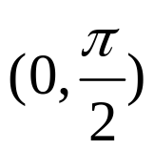
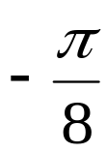





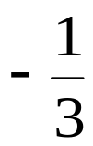

Example: Tangent Function
Example: Find the period and asymptotes and sketch the graph
of
y
1. Period of y = tan x is .
2. Find consecutive vertical
asymptotes by solving for x:
x
Vertical asymptotes:
3. Plot several points in
4. Sketch one branch and repeat.

Slide 22
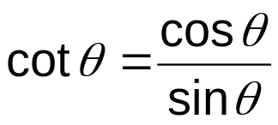


Cotangent Function
Recall that .
Since sin θ is in the denominator, when sin θ = 0, cot θ is undefined.
This occurs @ π intervals, starting at 0: { … −π, 0, π, 2π, … }
Let’s create an x/y table from θ = 0 to θ = π (one π interval),
with 5 input angle values.
θ | sin θ | cos θ | cot θ
0
π/4
π/2
3π/4
π
θ | cot θ
0 | Und ∞
π/4 | 1
π/2 | 0
3π/4 | −1
π | Und−∞
0
1
Und ∞
1
1
0
0
−1
0
–1
Und−∞

Slide 23
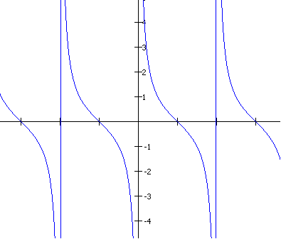

Graph of Cotangent Function: Periodic
Vertical asymptotes
where sin θ = 0
cot θ
θ | cot θ
0 | ∞
π/4 | 1
π/2 | 0
3π/4 | −1
π | −∞
−3π/2
-π
−π/2
π/2
π
3π/2
cot θ: Domain (angle measures): θ ≠ πn
Range (ratio of sides): all real numbers (−∞, ∞)
cot θ is an odd function; it is symmetric wrt the origin.
tan(−θ) = −tan(θ)

Slide 24
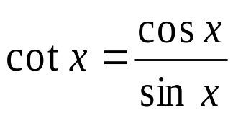













Cotangent Function
Graph of the Cotangent Function
To graph y = cot x, use the identity .
At values of x for which sin x = 0, the cotangent function is undefined and its graph has vertical asymptotes.
y
Properties of y = cot x
1. Domain : all real x
2. Range: (–∞, +∞)
x
3. Period: π
4. Vertical asymptotes:
vertical asymptotes

Slide 25
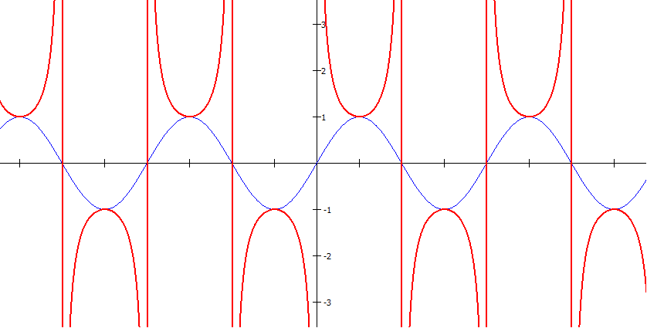
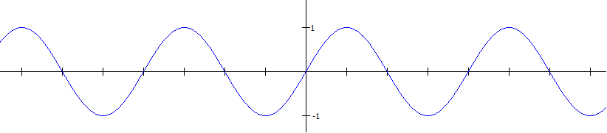
Cosecant is the reciprocal of sine
Vertical asymptotes
where sin θ = 0
csc θ
0
θ
−3π
−2π
−π
π
2π
3π
sin θ
One period: 2π
sin θ: Domain: (−∞, ∞)
Range: [−1, 1]
csc θ: Domain: θ ≠ πn
(where sin θ = 0)
Range: |csc θ| ≥ 1
or (−∞, −1] U [1, ∞]
sin θ and csc θ
are odd
(symm wrt origin)

Slide 26
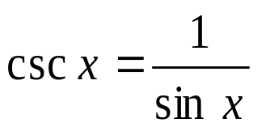





Cosecant Function
Graph of the Cosecant Function
To graph y = csc x, use the identity .
At values of x for which sin x = 0, the cosecant function
is undefined and its graph has vertical asymptotes.
y
Properties of y = csc x
1. domain : all real x
2. range: (–∞,–1] ∪ [1, +∞)
x
3. period: π
4. vertical asymptotes:
where sine is zero.

Slide 27
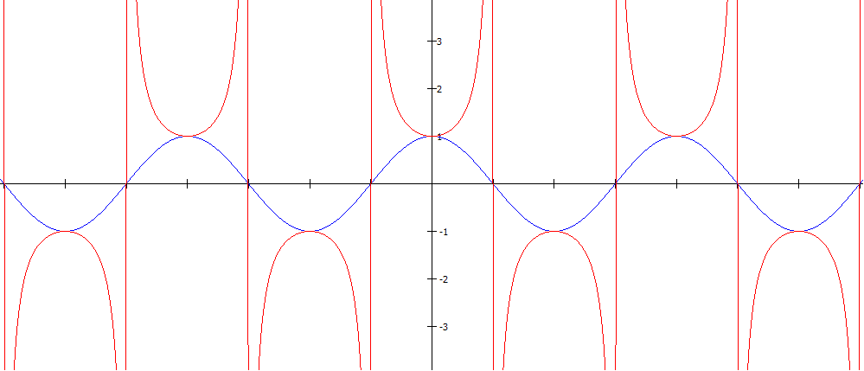
Secant is the reciprocal of cosine
Vertical asymptotes
where cos θ = 0
sec θ
θ
−3π
−2π
−π
0
π
2π
3π
cos θ
One period: 2π
cos θ: Domain: (−∞, ∞)
Range: [−1, 1]
sec θ: Domain: θ ≠ π/2 + πn
(where cos θ = 0)
Range: |sec θ | ≥ 1
or (−∞, −1] U [1, ∞]
cos θ and sec θ
are even
(symm wrt y-axis)

Slide 28
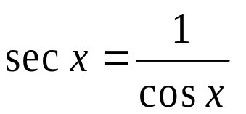

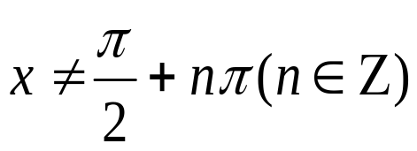


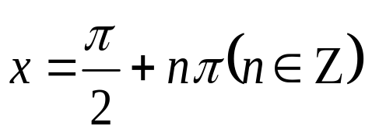
Secant Function
Graph of the Secant Function
The graph y = sec x, use the identity .
At values of x for which cos x = 0, the secant function is undefined and its graph has vertical asymptotes.
y
Properties of y = sec x
1. domain : all real x
2. range: (–∞,–1] ∪ [1, +∞)
x
3. period: 2π
4. vertical asymptotes:

Slide 29
Summary of Graph Characteristics
 | Def’n ∆ о |  | Period | Domain | Range | Even/Odd
sin θ
csc θ
cos θ
sec θ
tan θ
cot θ

Slide 30
Summary of Graph Characteristics
 | Def’n ∆ о |  | Period | Domain | Range | Even/Odd
sin θ | opp hyp | y r | 2π | (−∞, ∞) | −1 ≤ x ≤ 1 or [−1, 1] | odd
csc θ | 1 .sinθ | r .y | 2π | θ ≠ πn | |csc θ| ≥ 1 or (−∞, −1] U [1, ∞) | odd
cos θ | adj hyp | x r | 2π | (−∞, ∞) | All Reals or (−∞, ∞) | even
sec θ | 1 . cosθ | r y | 2π | θ ≠ π2 +πn | |sec θ| ≥ 1 or (−∞, −1] U [1, ∞) | even
tan θ | sinθ cosθ | y x | π | θ ≠ π2 +πn | All Reals or (−∞, ∞) | odd
cot θ | cosθ .sinθ | x y | π | θ ≠ πn | All Reals or (−∞, ∞) | odd

Slide 31
Translations of Trigonometric Graphs
Without looking at your notes, try to sketch the basic shape of each trig function:
1) Sine:
2) Cosine:
3) Tangent:

Slide 32
More Transformations
We have seen two types of transformations on trig graphs: vertical stretches and horizontal stretches.
There are three more: vertical translations (slides), horizontal translations, and reflections (flips).

Slide 33
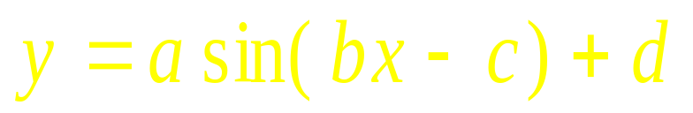
More Transformations
Here is the full general form for the sine function:
Just as with parabolas and other functions, c and d are translations:
c slides the graph horizontally (opposite of sign)
d slides the graph vertically
Also, if a is negative, the graph is flipped vertically.

Slide 34
More Transformations
To graph a sine or cosine graph:
Graph the original graph with the correct amplitude and period.
Translate c units horizontally and d units vertically.
Reflect vertically at its new position if a is negative (or reflect first, then translate).

Slide 35
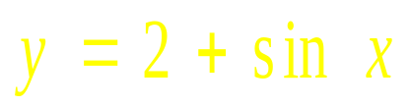
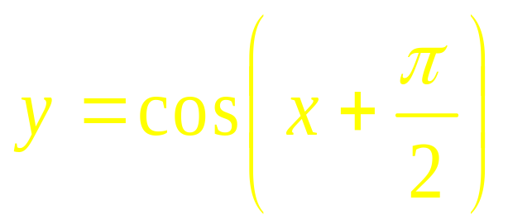
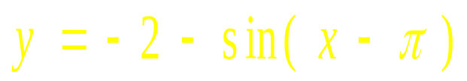
Examples
Describe how each graph would be transformed:

Slide 36
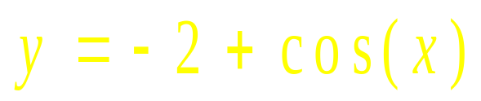
Examples
State the amplitude and period, then graph:
x
-2π
2π

Slide 37
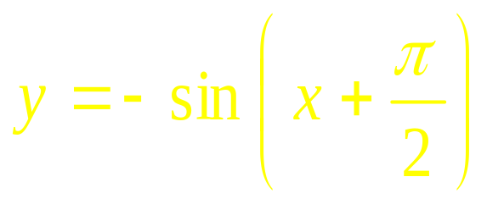
Examples
State the amplitude and period, then graph:
x
-2π
2π

Slide 38
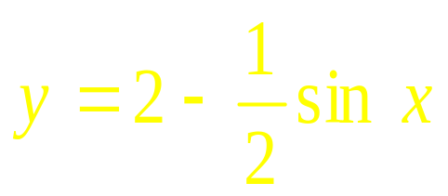
Examples
State the amplitude and period, then graph:
x
-2π
2π

Slide 39
Examples
Write an equation of the graph described:
The graph of y = cos x translated up 3 units, right π units, and reflected vertically.

